Slide 1
Salary Budget Simulator for City of Madison
-By Xi He

Slide 2
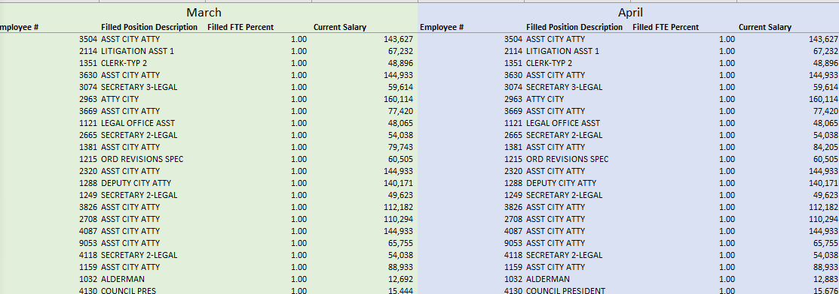
Reading Complex Data Set
Month information is in the first row
Data recorded horizontally
Inconsistent Position Names
Notes:
The goal of this project is to make a salary budget simulator to predict future salary budget for city of Madison. This is the data set provided by City of Madison. It contains many information of individual employees, such as Current Salary, employee#, and job description. However, this data set is very complex. For example, the month information is provided in the first row. One employee can have slightly different job title. Therefore, using this data set directly will not allow me to do data analysis.

Slide 3
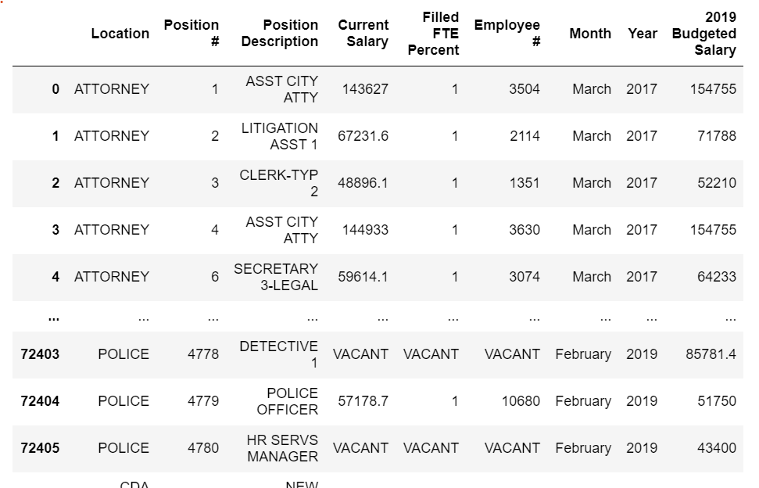
Reading Complex Data Set
Python Codes
Easy for data analysis
Notes:
By using python codes, I create a new data table. I can do data analysis easier with this new table.

Slide 4
Variables in the Budget Simulator
Hire Rates
Overall Average(<= 24 available data)
Based on Positions(>24 available data)
Retire Rates
Overall Average(<= 24 available data)
Based on Positions(>24 available data)
Position of Employees
Salary Growth Rates (Depends on positions)
Salary Growth Probability(The number of times salary increased in a year)
Current Salary
Notes:
After doing some data analysis, I decide to include six variables into my budget simulator. They are: ………
For hire rates and retire rates, because I only have two years data, it hard to calculate retire and hire rates for every positions. Therefore, for positions which have less than 24 available data, I used overall average rates for their hire and retire rates. I use the number of salary increases in a year to represent salary growth probability

Slide 5
How To Generate A Salary Budget Simulator
For Every Employee
Random Number < Hire Rates:
Hire a new employee with same position
Starting Salary based on the average salary for this position in the previous year
Current Salary, Position
2017 Data
Random Number < Retire Rates:
Lay off the current employee
Current Salary* (1+Salary Growth Rates)^^{Growth Times}
Notes:
Here is how to generate a salary budget simulator. I use 2017 as the base year. I used data from 2017 to generate simulations. For every employees, my simulator will do these three steps. The python will generate a random number, if this number is below the hire rates: the simulator will hire an employee, and the starting salary is based on the average salary for this position in the previous year. The python will generate another random variable, if this number is less than the retire rates, the current employee will retire. As I mention before, the hire rates and retire rates will either on depend the position of employees or using the overall average rates. The last methemical formula here is to predict the salary of individual employee for next year.

Slide 6

How To Generate A Salary Budget Simulator
Run 1000 Times
Random Number < Retire Rates:
Lay off a current employee
Current Salary* (1+Salary Growth Rates)^^{Growth Times}
Notes:
Then I those steps for 1000 times.

Slide 7
How To Generate A Salary Budget Simulator
Some Data Go Crazy
$170 thousands → $400 thousands 10 years later
Set Limit:
Current Salary < $50,000 → $100,000
$50,000<Current Salary < $100,000 →$150,000
Current Salary > $100,000 →$250,000
Notes:
One thing that I realize is that some data can go crazy. One person who has salary about $170 thousands recently. My simulator predicts that this person will earn about $400 thousands dollar per year 10 years later if I allow this person’s salary to growth forever. Therefore, I set some upper limits for salaries based on my intuition. For example, for job position which earn more than 100,000 dollar / year , the highest salary this position can reach is $250,000 /year

Slide 8
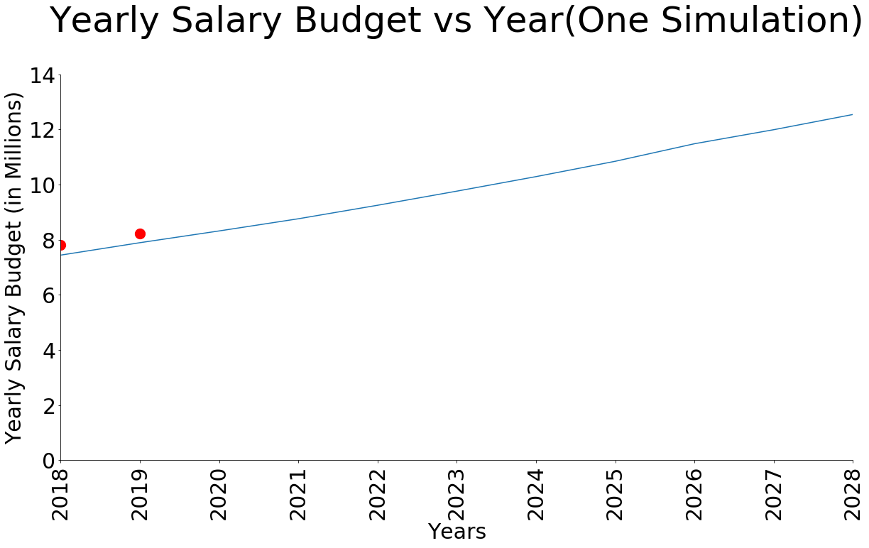
Result(Engineer Department)
2 month data /2* 12
Notes:
This plot shows the results of one single simulation from 2018 to 2028 for engineer department. As I mention before, I use data from 2017 as the base year. The red dot represents the actual salary budget in 2018 and 2019. For 2019, I only have data for first 2 months. Therefore, I calculated the average salary spending for one month and multiply the number by 12 to predict actual budget. You can see that the result predicted by my simulator is very close to the actual budget for 2018 and 2019.

Slide 9
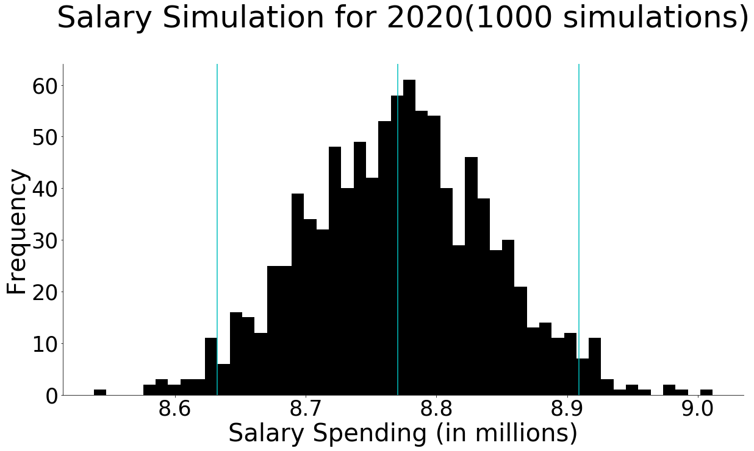
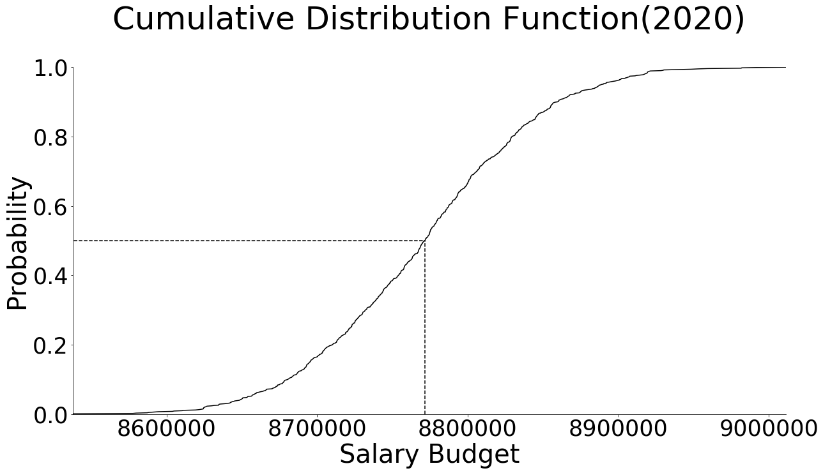
Engineer Department
Notes:
These two plots shows the distribution and cdf of 1000 simulations for engineer department. Cumulative Distribution Function is probability that a variable is less than or equal to certain value. My simulator predict that engineer department will spend 8.8 miilion dollars in 2020

Slide 10
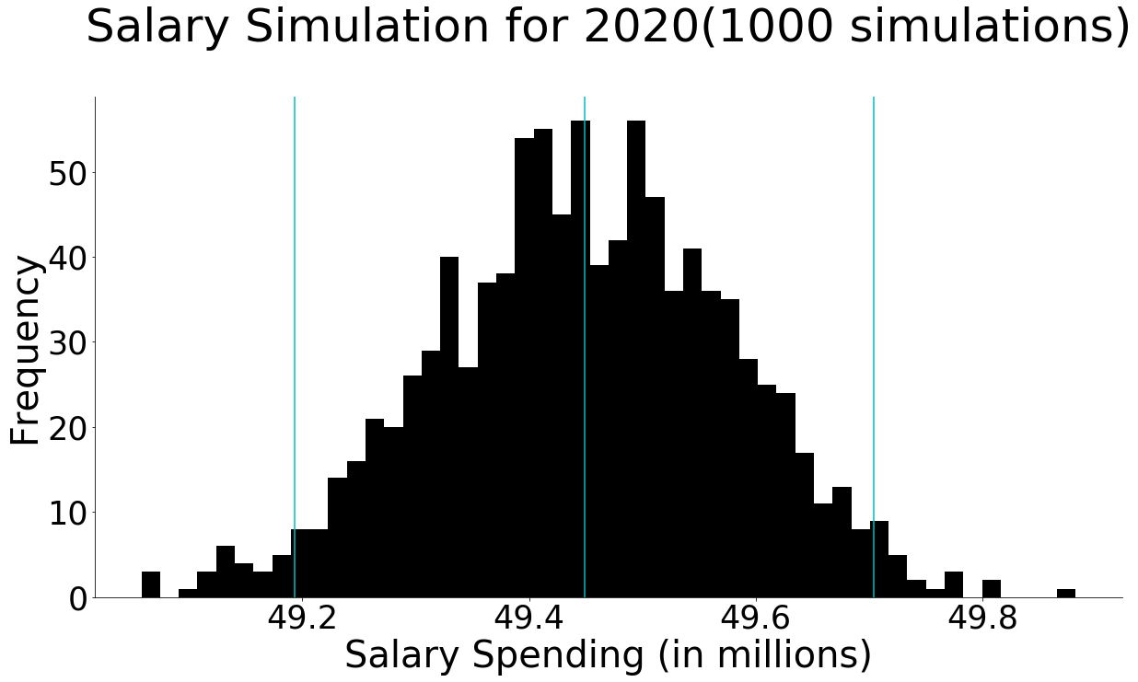
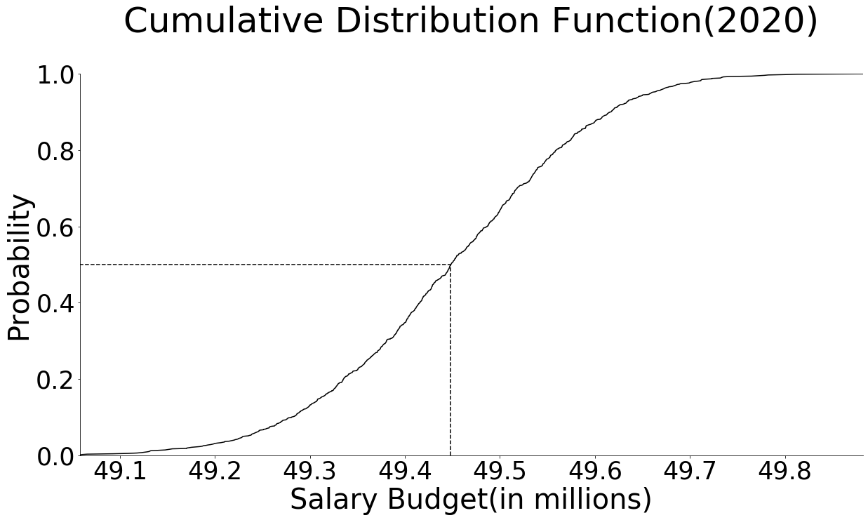
Police Department
Notes:
This is for Police Department. My simulator predict that engineer department will spend 49.4 miilion dollars in 2020

Slide 11
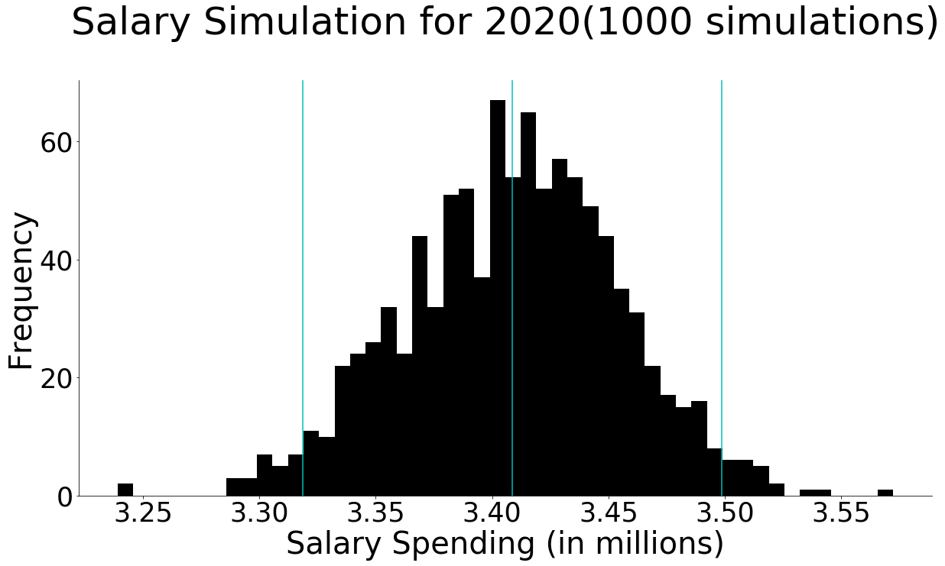
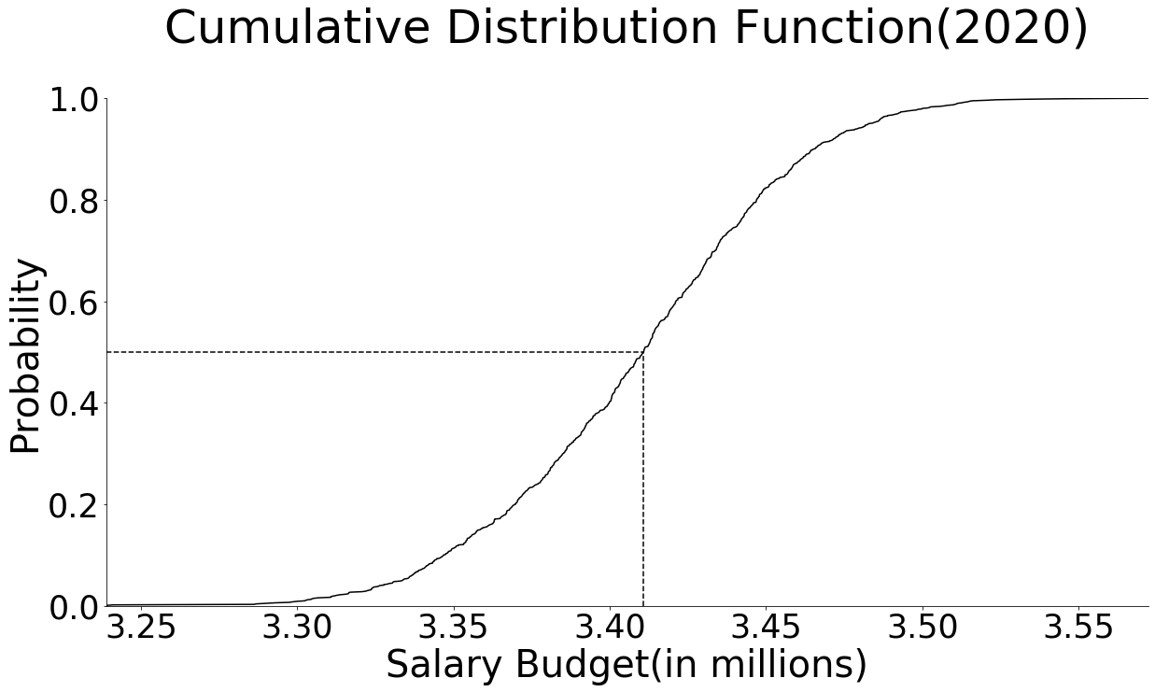
Finance Department
Notes:
This is for finance department. My simulator predict that finance department will spend 3.4 miilion dollars in 2020

Slide 12
Thank You

